Slide 1
Web Systems and Technologies
Chapter 2.
Hyper Text Markup Language (HTML)

Slide 2
Content
Introduction to HTML
HTML Structure
HTML Basics
HTML Tables
HTML Forms

Slide 3
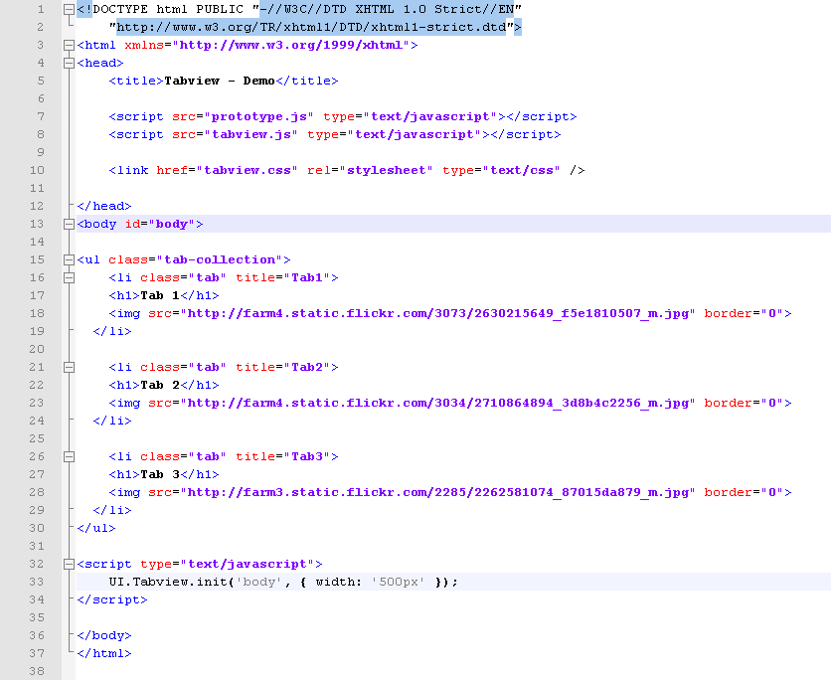
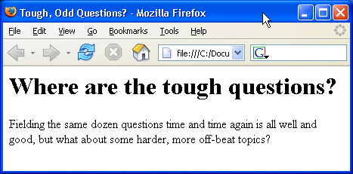
HTML Structure
HTML Document Structure in Depth

Slide 4
Introduction to HTML
HTML is a MARKUP language
Using HTML tags and elements, we can:
Control the appearance of the page and the content
Publish online documents and retrieve online information using the links inserted in the HTML document
Create on-line forms. These forms can be used to collect information about the user, conduct transactions, and so on

Slide 5
Concepts in HTML
Tags
Opening tag and closing tag
The smallest piece in HTML
Attributes
Properties of the tag
Size, color, etc…
Elements
Combination of opening, closing tag and attributes

Slide 6
HTML Structure
HTML is comprised of “elements” and “tags”
Begins with <html> and ends with </html>
Elements (tags) are nested one inside another:
Tags have attributes:
HTML describes structure using two main sections: <head> and <body>
<html> <head></head> <body></body> </html>
<img src="logo.jpg" alt="logo" />

Slide 7
HTML Tags
HTML tag is used to mark the beginning and end of an HTML document
<HTML> . . . </HTML>
The HTML tag is comprised of:
<ELEMENT ATTRIBUTE = “value”>
Element - identifies the tag
Attribute - describes the tag
Value - the content that is assigned to the attribute

Slide 8
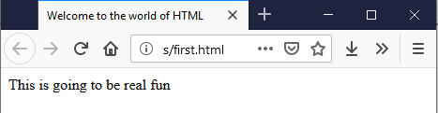
Structure of an HTML document
The HTML Section
The Header Section
The BODY Section
<!DOCTYPE HTML>
<HTML>
<HEAD>
<TITLE> Welcome to the world of HTML </TITLE>
</HEAD>
<BODY>
<P> This is going to be real fun </P>
</BODY>
</HTML>
Opening tag
Closing tag

Slide 9
Structure of an HTML document (cont.)
HTML Header
<!DOCTYPE HTML>
<HTML>
<HEAD>
<TITLE> Welcome to the world of HTML </TITLE>
</HEAD>
<BODY>
<P> This is going to be real fun </P>
</BODY>
</HTML>
HTML Body

Slide 10
Tags Attributes
Tags can have attributes
Attributes specify properties and behavior
Example:
Few attributes can apply to every element:
id, style, class, title
The id is unique in the document
Content of title attribute is displayed as hint when the element is hovered with the mouse
Some elements have obligatory attributes
Attribute alt with value "logo"
<img src="logo.gif" alt="logo" />

Slide 11
The <!DOCTYPE> Declaration
HTML documents must start with a document type definition (DTD)
It tells web browsers what type is the served code
Possible versions: HTML 4.01, XHTML 1.0 (Transitional or Strict), XHTML 1.1, HTML 5
Example:
See http://w3.org/QA/2002/04/valid-dtd-list.html for a list of possible doctypes
<!DOCTYPE html PUBLIC "-//W3C//DTD XHTML 1.0 Transitional//EN" "http://www.w3.org/TR/xhtml1/DTD/xhtml1-transitional.dtd">

Slide 12
The <head> Section
Contains information that doesn’t show directly on the viewable page
Starts after the <!doctype> declaration
Begins with <head> and ends with </head>
Contains mandatory single <title> tag
Can contain some other tags, e.g.
<meta>
<script>
<style>
<!–- comments -->

Slide 13
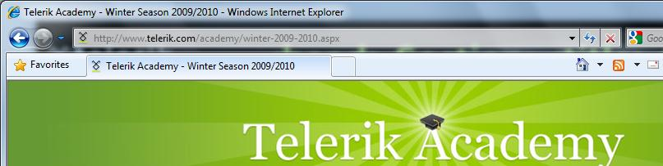
<head> Section: <title> tag
Title should be placed between <head> and </head> tags
Used to specify a title in the window title bar
Search engines and people rely on titles
<title>Telerik Academy – Winter Season 2009/2010 </title>

Slide 14
<head> Section: <meta>
Meta tags additionally describe the content contained within the page
<meta name="description" content="HTML tutorial" />
<meta name="keywords" content="html, web design, styles" />
<meta name="author" content="Chris Brewer" />
<meta http-equiv="refresh" content="5; url=http://www.telerik.com" />

Slide 15
<head> Section: <script>
The <script> element is used to embed scripts into an HTML document
Script are executed in the client's Web browser
Scripts can live in the <head> and in the <body> sections
Supported client-side scripting languages:
JavaScript (it is not Java!)
VBScript
JScript

Slide 16
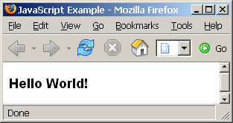
The <script> Tag – Example
<!DOCTYPE HTML>
<html>
<head>
<title>JavaScript Example</title>
<script type="text/javascript">
function sayHello() {
document.write("<p>Hello World!<\/p>");
}
</script>
</head>
<body>
<script type="text/javascript">
sayHello();
</script>
</body>
</html>

Slide 17
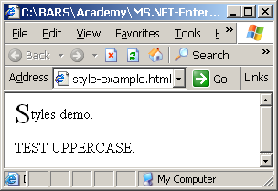
<head> Section: <style>
The <style> element embeds formatting information (CSS styles) into an HTML page
<html>
<head>
<style type="text/css">
p { font-size: 12pt; line-height: 12pt; }
p:first-letter { font-size: 200%; }
span { text-transform: uppercase; }
</style>
</head>
<body>
<p>Styles demo.<br />
<span>Test uppercase</span>.
</p>
</body>
</html>

Slide 18
Comments: <!-- --> Tag
Comments can exist anywhere between the <html></html> tags
Comments start with <!-- and end with -->
<!–- Telerik Logo (a JPG file) -->
<img src="logo.jpg" alt=“Telerik Logo">
<!–- Hyperlink to the web site -->
<a href="http://telerik.com/">Telerik</a>
<!–- Show the news table -->
<table class="newstable">
...

Slide 19
<body> Section: Introduction
The <body> section describes the viewable portion of the page
Starts after the <head> </head> section
Begins with <body> and ends with </body>
<html>
<head><title>Test page</title></head>
<body>
<!-- This is the Web page body -->
</body>
</html>

Slide 20



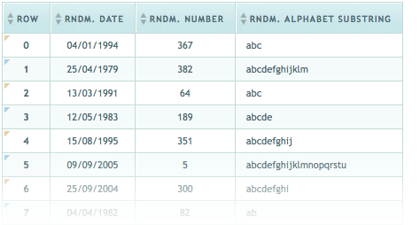

HTML Basics
Text, Images, Tables, Forms

Slide 21
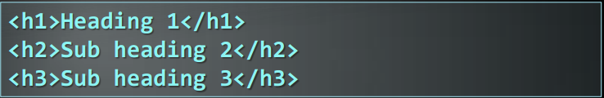

Headings and Paragraphs
Heading Tags (h1 – h6)
Paragraph Tags
<br />new line<br />

Slide 22
Text Formatting
Text formatting tags modify the text between the opening tag and the closing tag
Ex. <b>Hello</b> makes “Hello” bold
<b></b> | bold
<i></i> | italicized
<u></u> | underlined
<sup></sup> | Sample^{superscript}
<sub></sub> | Sample_{subscript}
<strong></strong> | strong
<em></em> | emphasized
<pre></pre> | Preformatted text
<blockquote></blockquote> | Quoted text block
<del></del> | Deleted text – strike through

Slide 23
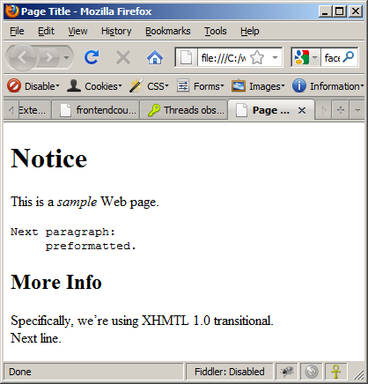
Text Formatting – Example
<!DOCTYPE html PUBLIC "-//W3C//DTD XHTML 1.0 Transitional//EN"
"http://www.w3.org/TR/xhtml1/DTD/xhtml1-transitional.dtd">
<html>
<head>
<title>Page Title</title>
</head>
<body>
<h1>Notice</h1>
<p>This is a <em>sample</em> Web page.</p>
<p><pre>Next paragraph:
preformatted.</pre></p>
<h2>More Info</h2>
<p>Specifically, we’re using XHMTL 1.0 transitional.<br />
Next line.</p>
</body>
</html>

Slide 24
Hyperlinks: <a> Tag
Link to a document called form.html on the same server in the same directory:
Link to a document called parent.html on the same server in the parent directory:
Link to a document called cat.html on the same server in the subdirectory stuff:
<a href="form.html">Fill Our Form</a>
<a href="../parent.html">Parent</a>
<a href="stuff/cat.html">Catalog</a>

Slide 25
Hyperlinks: <a> Tag (2)
Link to an external Web site:
Always use a full URL, including "http://", not just "www.somesite.com"
Using the target="_blank" attribute opens the link in a new window
Link to an e-mail address:
<a href="http://www.devbg.org" target="_blank">BASD</a>
<a href="mailto:bugs@example.com?subject=Bug+Report">
Please report bugs here (by e-mail only)</a>

Slide 26
Hyperlinks: <a> Tag (3)
Link to a document called apply-now.html
On the same server, in same directory
Using an image as a link button:
Link to a document called index.html
On the same server, in the subdirectory english of the parent directory:
<a href="apply-now.html"><img
src="apply-now-button.jpg" /></a>
<a href="../english/index.html">Switch to English version</a>

Slide 27
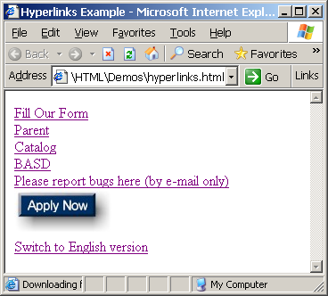
Hyperlinks – Example
hyperlinks.html
<a href="form.html">Fill Our Form</a> <br />
<a href="../parent.html">Parent</a> <br />
<a href="stuff/cat.html">Catalog</a> <br />
<a href="http://www.devbg.org" target="_blank">BASD</a> <br />
<a href="mailto:bugs@example.com?subject=Bug Report">Please report bugs here (by e-mail only)</a>
<br />
<a href="apply-now.html"><img src="apply-now-button.jpg” /></a> <br />
<a href="../english/index.html">Switch to English version</a> <br />

Slide 28
Hyperlinks and Sections
Link to another location in the same document:
Link to a specific location in another document:
<a href="#section1">Go to Introduction</a>
...
<h2 id="section1">Introduction</h2>
<a href="chapter3.html#section3.1.1">Go to Section 3.1.1</a>
<!–- In chapter3.html -->
...
<div id="section3.1.1">
<h3>3.1.1. Technical Background</h3>
</div>

Slide 29
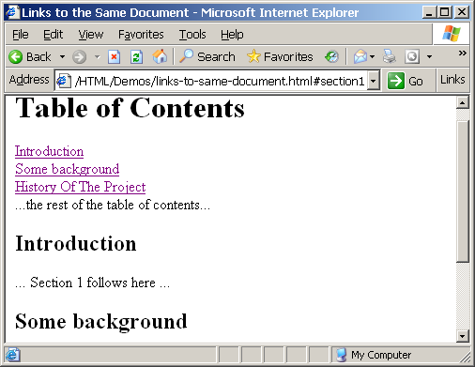
Links to the Same Document – Example
<h1>Table of Contents</h1>
<p><a href="#section1">Introduction</a><br />
<a href="#section2">Some background</A><br />
<a href="#section2.1">Project History</a><br />
...the rest of the table of contents...
<!-- The document text follows here -->
<h2 id="section1">Introduction</h2>
... Section 1 follows here ...
<h2 id="section2">Some background</h2>
... Section 2 follows here ...
<h3 id="section2.1">Project History</h3>
... Section 2.1 follows here ...

Slide 30
Images: <img> tag
Inserting an image with <img> tag:
Image attributes:
Example:
<img src="/img/basd-logo.png">
src | Location of image file (relative or absolute)
alt | Substitute text for display (e.g. in text mode)
height | Number of pixels of the height
width | Number of pixels of the width
border | Size of border, 0 for no border
<img src="./php.png" alt="PHP Logo" />

Slide 31
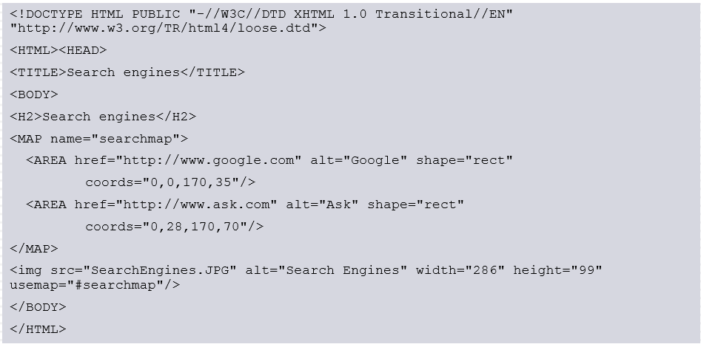
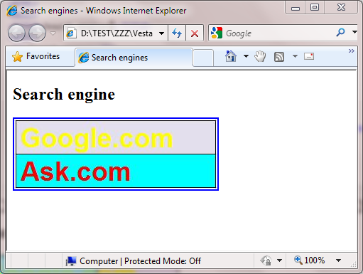
Image maps
There are diferrent areas that act as links in an image.
Map element
AREA element

Slide 32
OBJECT element
DATA: url of the resource
WIDTH
HEGHT
NAME
TYPE: media type

Slide 33
Audio & Video
Media Tags
<audio>
Attributes: autoplay, controls, loop, src
<video>
Attributes: autoplay, controls, loop, height, width, src
<audio width="360" height="240" controls= "controls" >
<source src="someSong.mp3" type="audio/mp3">
</source>
Audio tag is not supported
</audio>

Slide 34
Embed Tag – New Syntax
<embed>
Defines embedded content, such as a plug-in
Attributes
src="url“
type="type"
<embed src="helloworld.swf" />

Slide 35
Miscellaneous Tags
<hr />: Draws a horizontal rule (line):
<center></center>: Deprecated!
<font></font>: Deprecated!
<hr size="5" width="70%" />
<center>Hello World!</center>
<font size="3" color="blue">Font3</font>
<font size="+4" color="blue">Font+4</font>

Slide 36
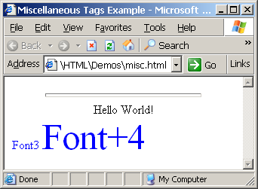
Miscellaneous Tags – Example
<html>
<head>
<title>Miscellaneous Tags Example</title>
</head>
<body>
<hr size="5" width="70%" />
<center>Hello World!</center>
<font size="3" color="blue">Font3</font>
<font size="+4" color="blue">Font+4</font>
</body>
</html>

Slide 37
Ordered Lists: <ol> Tag
Create an Ordered List using <ol></ol>:
Attribute values for type are 1, A, a, I, or i
<ol type="1">
<li>Apple</li>
<li>Orange</li>
<li>Grapefruit</li>
</ol>
Apple
Orange
Grapefruit
Apple
Orange
Grapefruit
Apple
Orange
Grapefruit
Apple
Orange
Grapefruit
Apple
Orange
Grapefruit

Slide 38
Unordered Lists: <ul> Tag
Create an Unordered List using <ul></ul>:
Attribute values for type are:
disc, circle or square
<ul type="disk">
<li>Apple</li>
<li>Orange</li>
<li>Grapefruit</li>
</ul>
Apple
Orange
Pear
Apple
Orange
Pear
Apple
Orange
Pear

Slide 39
Definition lists: <dl> tag
Create definition lists using <dl>
Pairs of text and associated definition; text is in <dt> tag, definition in <dd> tag
Renders without bullets
Definition is indented
<dl>
<dt>HTML</dt>
<dd>A markup language …</dd>
<dt>CSS</dt>
<dd>Language used to …</dd>
</dl>

Slide 40
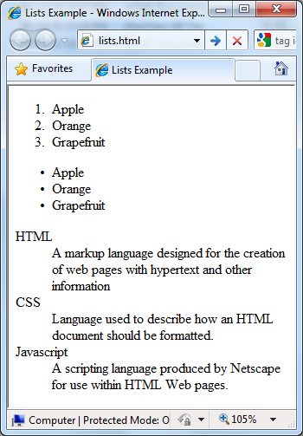
Lists – Example
<ol type="1">
<li>Apple</li>
<li>Orange</li>
<li>Grapefruit</li>
</ol>
<ul type="disc">
<li>Apple</li>
<li>Orange</li>
<li>Grapefruit</li>
</ul>
<dl>
<dt>HTML</dt>
<dd>A markup lang…</dd>
</dl>

Slide 41
HTML Special Characters
Symbol Name
HTML Entity
Symbol
Copyright Sign
&copy;
©
Registered Trademark Sign
&reg;
®
Trademark Sign
&trade;
™
Less Than
&lt;
<
Greater Than
&gt;
>
Ampersand
&amp;
&
Non-breaking Space
&nbsp;
Em Dash
&mdash;
—
Quotation Mark
&quot;
"
Euro
&#8364;
€
British Pound
&pound;
£
Japanese Yen
&yen;
¥

Slide 42
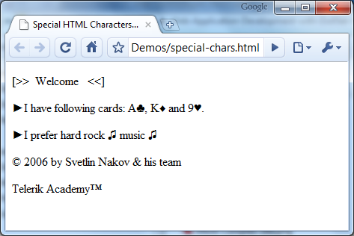
Special Chars – Example
<p>[&gt;&gt;&nbsp;&nbsp;Welcome
&nbsp;&nbsp;&lt;&lt;]</p>
<p>&#9658;I have following cards:
A&#9827;, K&#9830; and 9&#9829;.</p>
<p>&#9658;I prefer hard rock &#9835;
music &#9835;</p>
<p>&copy; 2006 by Svetlin Nakov &amp; his team</p>
<p>Telerik Academy™</p>

Slide 43

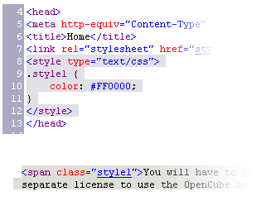
Block and Inline Elements
Block elements add a line break before and after them
<div> is a block element
Other block elements are <table>, <hr>, headings, lists, <p> and etc.
Inline elements don’t break the text before and after them
<span> is an inline element
Most HTML elements are inline, e.g. <a>

Slide 44
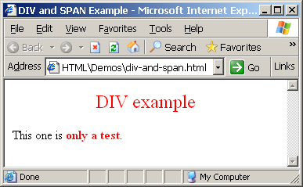
The <div> Tag
<div> creates logical divisions within a page
Block style element
Used with CSS
Example:
div-and-span.html
<div style="font-size:24px; color:red">DIV example</div>
<p>This one is <span style="color:red; font-weight:bold">only a test</span>.</p>

Slide 45
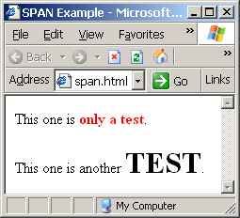
The <span> Tag
Inline style element
Useful for modifying a specific portion of text
Don't create a separate area (paragraph) in the document
Very useful with CSS
span.html
<p>This one is <span style="color:red; font-weight:bold">only a test</span>.</p>
<p>This one is another <span style="font-size:32px; font-weight:bold">TEST</span>.</p>

Slide 46
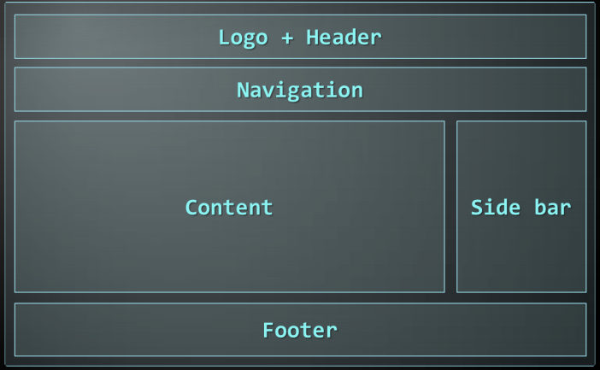
DIV with The Structure of a Web Page
A sample layout structure of a Web Page

Slide 47
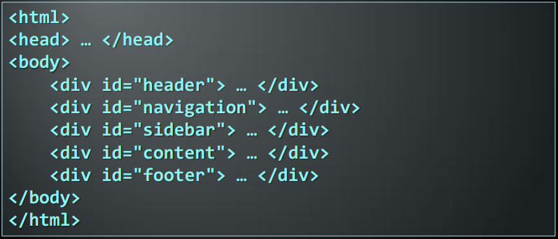
The "HTML 4 and Before" Way
Using divs with IDs
The IDs are needed for styling

Slide 48
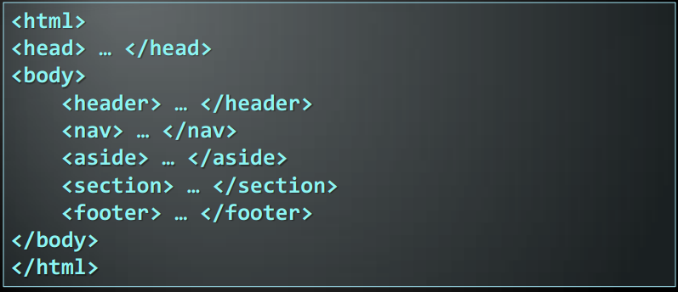
The HTML 5 Way
In HTML 5 there are semantic tags for layout
<nav>, <header>, <footer>, <section>

Slide 49
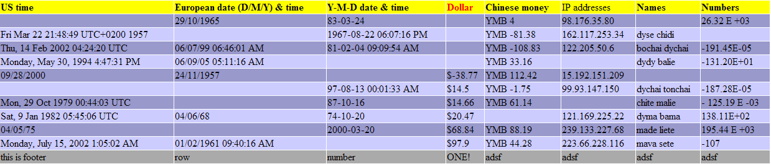
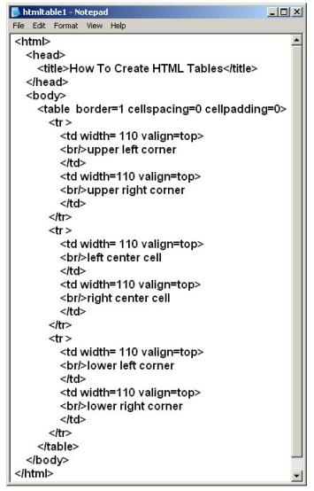
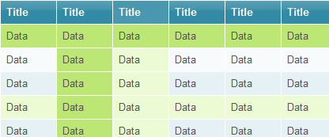
HTML Tables

Slide 50
HTML Tables
Tables represent tabular data
A table consists of one or several rows
Each row has one or more columns
Tables comprised of several core tags:
<table></table>: begin / end the table
<tr></tr>: create a table row
<td></td>: create tabular data (cell)
Tables should not be used for layout. Use CSS floats and positioning styles instead

Slide 51
HTML Tables (2)
Start and end of a table
Start and end of a row
Start and end of a cell in a row
<table> ... </table>
<tr> ... </tr>
<td> ... </td>

Slide 52
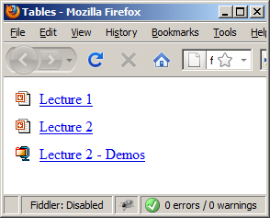
Simple HTML Tables – Example
<table cellspacing="0" cellpadding="5">
<tr>
<td><img src="ppt.gif"></td>
<td><a href="lecture1.ppt">Lecture 1</a></td>
</tr>
<tr>
<td><img src="ppt.gif"></td>
<td><a href="lecture2.ppt">Lecture 2</a></td>
</tr>
<tr>
<td><img src="zip.gif"></td>
<td><a href="lecture2-demos.zip">
Lecture 2 - Demos</a></td>
</tr>
</table>

Slide 53
Complete HTML Tables
Table rows split into three semantic sections: header, body and footer
<thead> denotes table header and contains <th> elements, instead of <td> elements
<tbody> denotes collection of table rows that contain the very data
<tfoot> denotes table footer but comes BEFORE the <tbody> tag
<colgroup> and <col> define columns (most often used to set column widths)

Slide 54
Complete HTML Table: Example
<table>
<colgroup>
<col style="width:100px" /><col />
</colgroup>
<thead>
<tr><th>Column 1</th><th>Column 2</th></tr>
</thead>
<tfoot>
<tr><td>Footer 1</td><td>Footer 2</td></tr>
</tfoot>
<tbody>
<tr><td>Cell 1.1</td><td>Cell 1.2</td></tr>
<tr><td>Cell 2.1</td><td>Cell 2.2</td></tr>
</tbody>
</table>
columns
header
th
footer
Last comes the body (data)

Slide 55
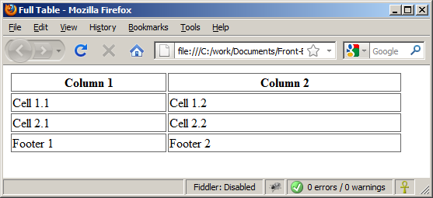
Complete HTML Table: Example (2)
<table>
<colgroup>
<col style="width:200px" /><col />
</colgroup>
<thead>
<tr><th>Column 1</th><th>Column 2</th></tr>
</thead>
<tfoot>
<tr><td>Footer 1</td><td>Footer 2</td></tr>
</tfoot>
<tbody>
<tr><td>Cell 1.1</td><td>Cell 1.2</td></tr>
<tr><td>Cell 2.1</td><td>Cell 2.2</td></tr>
</tbody>
</table>
By default, header text is bold and centered.
Although the footer is before the data in the code, it is displayed last

Slide 56
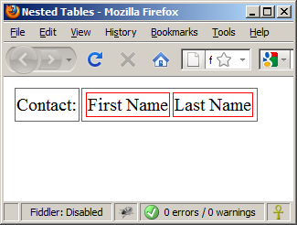
Nested Tables
Table data “cells” (<td>) can contain nested tables (tables within tables):
nested-tables.html
<table>
<tr>
<td>Contact:</td>
<td>
<table>
<tr>
<td>First Name</td>
<td>Last Name</td>
</tr>
</table>
</td>
</tr>
</table>

Slide 57
Cell Spacing and Padding
Tables have two important attributes:
cellspacing
Defines the empty space between cells
cellpadding
Defines the empty space around the cell content
cell
cell
cell
cell
cell
cell
cell
cell

Slide 58
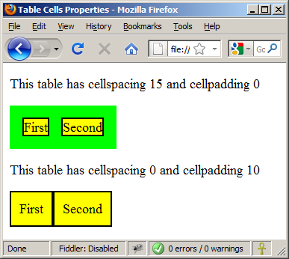
Cell Spacing and Padding – Example
<html>
<head><title>Table Cells</title></head>
<body>
<table cellspacing="15" cellpadding="0">
<tr><td>First</td>
<td>Second</td></tr>
</table>
<br/>
<table cellspacing="0" cellpadding="10">
<tr><td>First</td><td>Second</td></tr>
</table>
</body>
</html>

Slide 59
Column and Row Span
Table cells have two important attributes:
colspan
Defines how many columns the cell occupies
rowspan
Defines how many rows the cell occupies
colspan="1"
colspan="1"
rowspan="2"
rowspan="1"
cell[1,1]
cell[1,2]
cell[1,1]
cell[1,2]
cell[2,1]
cell[2,1]
colspan="2"
rowspan="1"

Slide 60
Column and Row Span – Example
<table cellspacing="0">
<tr class="1"><td>Cell[1,1]</td>
<td colspan="2">Cell[2,1]</td></tr>
<tr class=“2"><td>Cell[1,2]</td>
<td rowspan="2">Cell[2,2]</td>
<td>Cell[3,2]</td></tr>
<tr class=“3"><td>Cell[1,3]</td>
<td>Cell[2,3]</td></tr>
</table>
Cell[1,1]
Cell[2,1]
Cell[1,2]
Cell[2,2]
Cell[3,2]
Cell[1,3]
Cell[2,3]

Slide 61
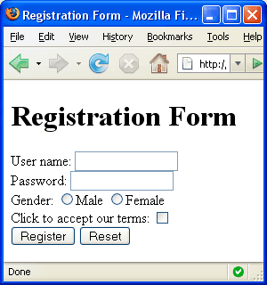

HTML Forms
Entering User Data from a Web Page

Slide 62
What are HTML Forms?
The primary method for gathering data from site visitors
HTML Forms can contain
Text fields for the user to type
Buttons for interactions like "Register", "Login", "Search"
Menus, Sliders, etc…
Check Google, Yahoo, Facebook
Google search field is a simple Text field

Slide 63
How to Create Forms?
Create a form block with
Example:
The "method" attribute tells how the form data should be sent – via GET or POST request
<form></form>
<form name="myForm" method="post" action="path/to/some-script.php">
...
</form>
The "action" attribute tells where the form data should be sent

Slide 64
Text Fields
Single-line text input fields:
Multi-line text input fields (textarea):
Password input – a text field which masks the entered text with * signs
<input type="text" name="FirstName" value="This is a text field" />
<textarea name="Comments">This is a multi-line text field</textarea>
<input type="password" name="pass" />

Slide 65
Buttons
Reset button – brings the form to its initial state
Submit button:
Image button – acts like submit but image is displayed and click coordinates are sent
Ordinary button – no default action, used with JS
<input type="reset" name="resetBtn" value="Reset the form" />
<input type="submit" value="Apply Now" />
<input type="image" src="submit.gif" name="submitBtn" alt="Submit" />
<input type="button" value="click me" />

Slide 66
Checkboxes and Radio Buttons
Checkboxes:
Radio buttons:
Radio buttons can be grouped, allowing only one to be selected from a group:
<input type="checkbox" name="fruit" value="apple" />
<input type="radio" name="title" value="Mr." />
<input type="radio" name="city" value="Lom" />
<input type="radio" name="city" value="Ruse" />

Slide 67
Select Fields
Dropdown menus:
Multiple-choice menus
<select name="gender">
<option value="Value 1"
selected="selected">Male</option>
<option value="Value 2">Female</option>
<option value="Value 3">Other</option>
</select>
<select name="products" multiple="multiple">
<option value="Value 1"
selected="selected">keyboard</option>
<option value="Value 2">mouse</option>
</select>

Slide 68
Hidden Fields
Hidden fields contain invisible data
Not shown to the user
Used by JavaScript and server-side code
ViewState, SessionState, etc..
<input type="hidden" name="Account" value="This is a hidden text field" />

Slide 69
File Input
File input – a field used for uploading files
When used, it requires the form element to have a specific attribute:
<form enctype="multipart/form-data">
...
<input type="file" name="photo" />
...
</form>

Slide 70
Labels
Labels are used to associate an explanatory text to a form field using the field's ID.
Clicking on a label focuses its associated field (checkboxes are toggled, radio buttons are checked)
Labels are both a usability and accessibility feature and are required in order to pass accessibility validation.
<label for="fn">First Name</label>
<input type="text" id="fn" />

Slide 71
Fieldsets
Fieldsets are used to enclose a group of related form fields:
The <legend> is the fieldset's title.
<form method="post" action="form.aspx">
<fieldset>
<legend>Client Details</legend>
<input type="text" id="Name" />
<input type="text" id="Phone" />
</fieldset>
<fieldset>
<legend>Order Details</legend>
<input type="text" id="Quantity" />
<textarea cols="40" rows="10" id="Remarks"></textarea>
</fieldset>
</form>

Slide 72
HTML Forms – Example
<form method="post" action="apply-now.php">
<input name="subject" type="hidden" value="Class" />
<fieldset><legend>Academic information</legend>
<label for="degree">Degree</label>
<select name="degree" id="degree">
<option value="BA">Bachelor of Art</option>
<option value="BS">Bachelor of Science</option>
<option value="MBA" selected="selected">Master of
Business Administration</option>
</select>
<br />
<label for="studentid">Student ID</label>
<input type="password" name="studentid" />
</fieldset>
<fieldset><legend>Personal Details</legend>
<label for="fname">First Name</label>
<input type="text" name="fname" id="fname" />
<br />
<label for="lname">Last Name</label>
<input type="text" name="lname" id="lname" />

Slide 73
HTML Forms – Example (2)
<br />
Gender:
<input name="gender" type="radio" id="gm" value="m" />
<label for="gm">Male</label>
<input name="gender" type="radio" id="gf" value="f" />
<label for="gf">Female</label>
<br />
<label for="email">Email</label>
<input type="text" name="email" id="email" />
</fieldset>
<p>
<textarea name="terms" cols="30" rows="4"
readonly="readonly">TERMS AND CONDITIONS...</textarea>
</p>
<p>
<input type="submit" name="submit" value="Send Form" />
<input type="reset" value="Clear Form" />
</p>
</form>

Slide 74
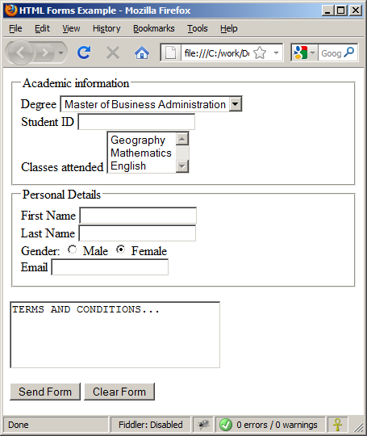
HTML Forms – Example (3)
form.html (continued)

Slide 75
Attributes from HTML 5
Autocomplete
The browser stores the previously typed values
Brings them back on a later visit on the same page
Autofocus
The field becomes on focus on page load
Required
The field is required to be filled/selected

Slide 76
Input Fields with Validation
Email – provides a simple validation for email
Can be passed a pattern for validation
On a mobile device brings the email keyboard
URL – has validation for url
On a mobile device brings the url keyboard
Telephone
Brings the numbers keyboard
<input type="email" required="true" pattern="[^ @]*@[^ @].[^ @]"/>
<input type="url" required="true" />
<input type="tel" required="true" />

Slide 77
Range and Spinbox
Restricts users to enter only numbers
Additional attributes min, max and step and value
Can become Spinbox or Slider, depending on the input type
Have some differences on different browsers
Sliders and Spinboxes do not work on Firefox
Shown as regular textboxes
<input type="range" min="0" max="100" />
<input type="number" min="0" max="100" />

Slide 78
TabIndex
The tabindex HTML attribute controls the order in which form fields and hyperlinks are focused when repeatedly pressing the TAB key
tabindex="0" (zero) - "natural" order
If X < Y, then elements with tabindex="X" are iterated before elements with tabindex="Y"
Elements with negative tabindex are skipped, however, this is not defined in the standard
<input type="text" tabindex="10" />

Slide 79
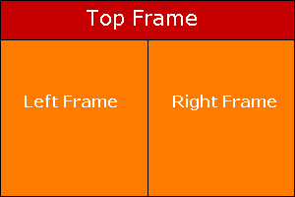
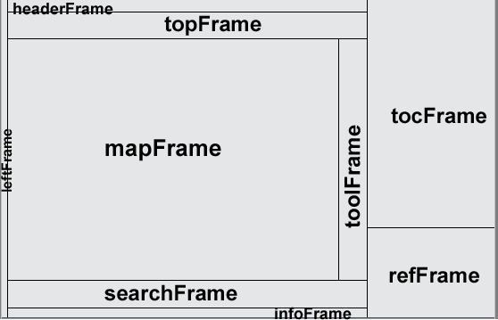
HTML Frames
Frames provide a way to show multiple HTML documents in a single Web page
The page can be split into separate views (frames) horizontally and vertically
Frames were popular in the early ages of HTML development, but now their usage is rejected
Frames are not supported by all user agents (browsers, search engines, etc.)
A <noframes> element is used to provide content for non-compatible agents.

Slide 80
Inline Frames: <iframe>
Inline frames provide a way to show one website inside another website:
<iframe name="iframeGoogle" width="600" height="400" src="http://www.google.com" frameborder="yes" scrolling="yes"></iframe>

Slide 81


